Slide 1
ECMWF Hackathon 2022: Visualising Meteorological Data
Deep Convection and El Niño
David Webb
Indrani Roy Nguyen Chien
With thanks to
Linus Magnusson

Slide 2
El Niños, which every few years are responsible for significant changes in
the large scale atmospheric circulation, can result in serious droughts
in South-east Asia and equally serious flooding in the Americas.
Research on the cause of El Niños has now been underway for over
50 years and yet there is still no clear understanding of the mechanisms
involved.
This hackathon project was based on the idea that the ECMWF ERA5 datasets include three very strong El Ninos (1983/84, 1997/98, 2015/16) and that the data was useful for starting to understand how deep atmospheric
convection might be triggered by changes in ocean currents.
This presentation refers to three video clips. These made this presentation too big to be uploaded to Github but can be copied from the hackathon Github page.

Slide 3
The next two slides show Pacific sea surface temperatures in September 1982 - which is taken to be a typical year and
September 1983 - during the growth of a strong El Niño.
What is noticeable about 1983 is the large region of warm water
carried eastwards by the North Equatorial Counter Current (NECC). Similar events are also seen in 1997 and 2015.
Much of the NECC water has a temperature greater than 28°C, the key temperature needed to trigger deep atmospheric convection.
So what does it do to the atmosphere?

Slide 4
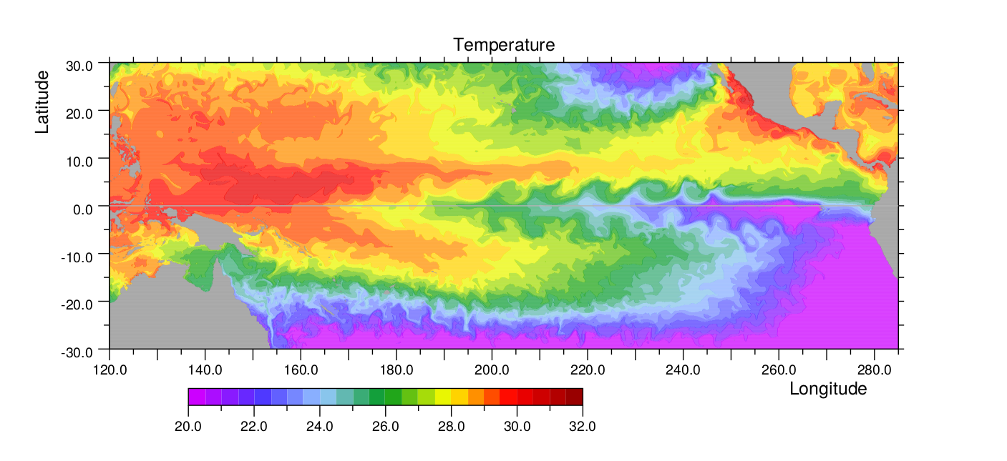
September 1981
North Equatorial Counter Current
Nino 3.4
Temperatures needed for deep atmospheric convection

Slide 5
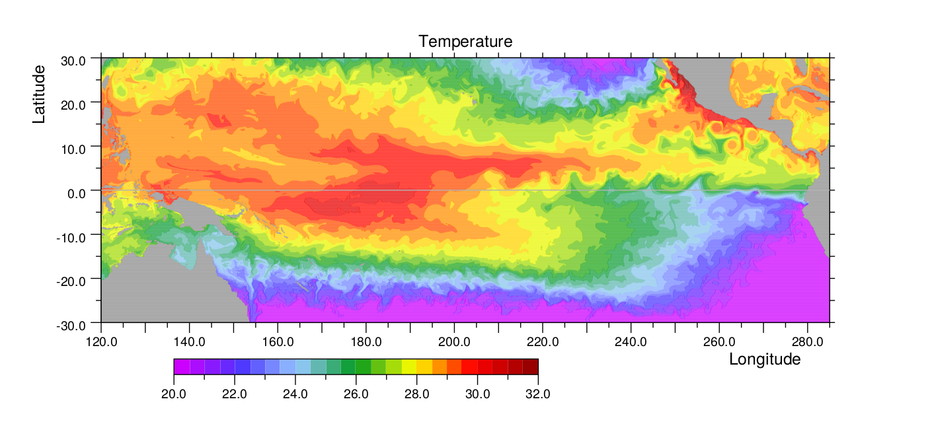
September 1982
Nino 3.4
Temperatures needed for deep atmospheric convection

Slide 6
The next two slides show vertical velocities across the atmospheric
pressure surface at 500 mb - i.e. about halfway through the atmosphere.
Surface pressure is around 1000mb and the bottom of the stratosphere is
usually around 200 mb. The figures use an area conserving projection.
The first shows the vertical velocity averaged between 1979 and 2021.
Note the strong convection over the Island Continent, and along the
Inter-Tropical Convergence Zone (ITCZ) that extends north of the Equator to the Americas.
The second shows the same but averaged over August 2015. Note the
reduced convection over the Island Continent and increased convection
over the western pacific and along the line of the ITCZ.

Slide 7
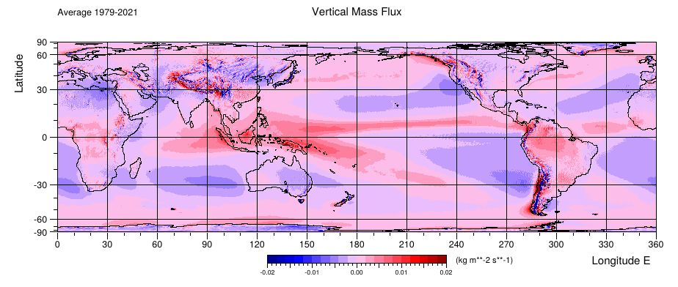

Slide 8
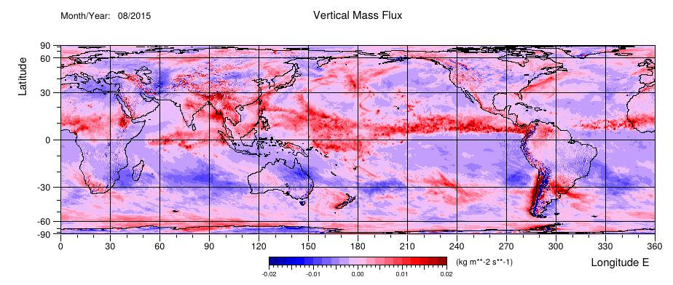

Slide 9
The monthly average result is interesting, but for the hackathon we
decided to produce a movie of the vertical velocity using the hourly
datasets available from the ERA5 archive.
The next slide shows the vertical velocity at 500mb at hourly intervals
from the first 10 days of August 2015. Although some deep convection
events can be seen, the result is dominated by noise.
[The result is unexpected because atmospheric models usually use
pressure coordinates to reduce the effect of gravity waves.]

Slide 10
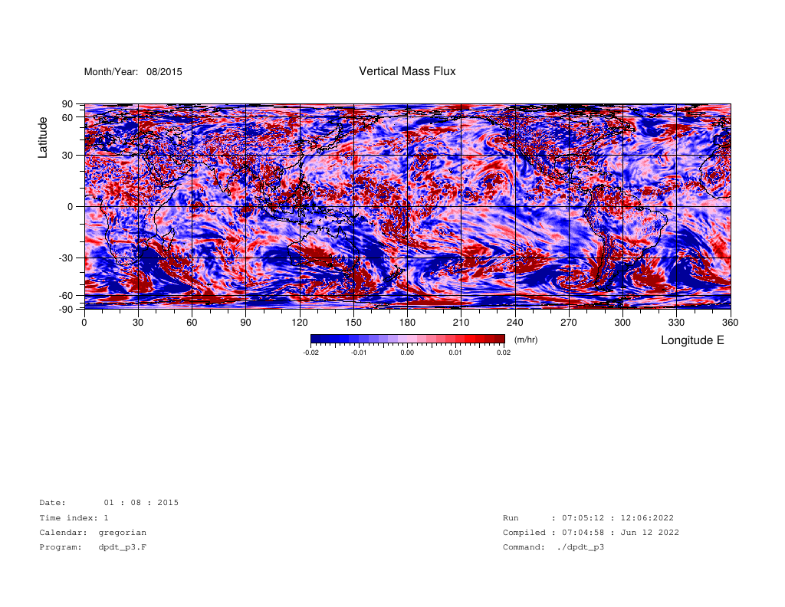
Github file: dpdt_hourly_500mb_2015_08_01to10.mp4

Slide 11
As an alternative it was suggested that we use heavy rainfall as
a measure of deep atmospheric convection.
The result is shown in the next movie, which covers the whole
month. As a background we use the monthly average vertical
velocity figure.
It emphasises how convection has moved from the Island Continent
into the western Pacific, the importance of the ITCZ and, in
comparison, how little convection occurs on the Equator in the
central and western Pacific.

Slide 12
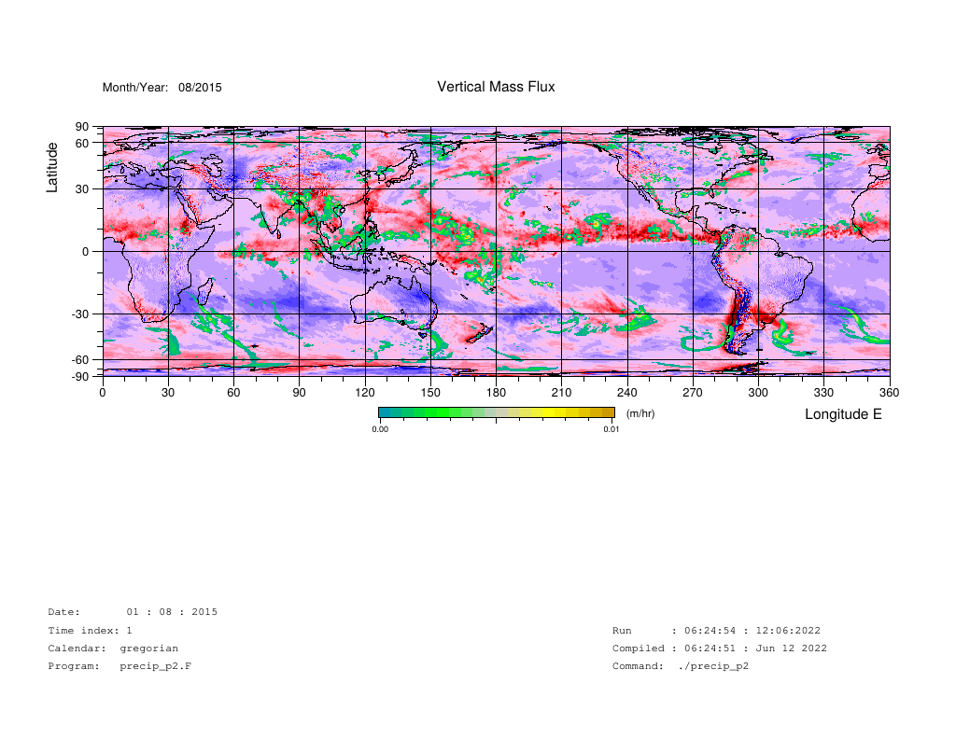
Github file: precip_hourly_2015_08.mp4

Slide 13
The final movie, that unfortunately was not ready for the hackathon presentation, shows the same rainfall field but
in the background shows monthly average of the sea surface
temperature, used for the ERA5 reanalysis.
The temperatures run from 20°C to 32°C, with step changes
in colour roughly every 1°C.
The temperatures are more spread out than was expected given
the model ocean results shown earlier. The next reanalysis ERA6,
plans to use both ocean and atmospheric models. The results
should be interesting!

Slide 14
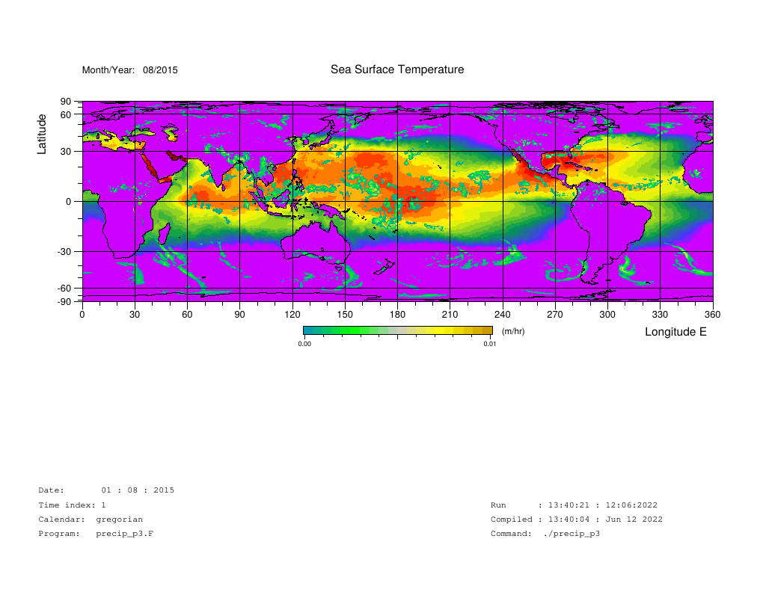
Github file: precip_hourly_SST_2015_08.mp4

Slide 15
Finally we would like to thank the staff of the ECMWF for
their help and thank everyone, including the other hacks,
for making the weekend so enjoyable.
There is only a limited amount a group can do in 24 hours
but ideas can be tried out and a lot can be learnt.
Nguyen Chien
Indrani Roy David Webb

